Slide 1

PLATFORM AS A SERVICE
By Sai Kumar

Slide 2
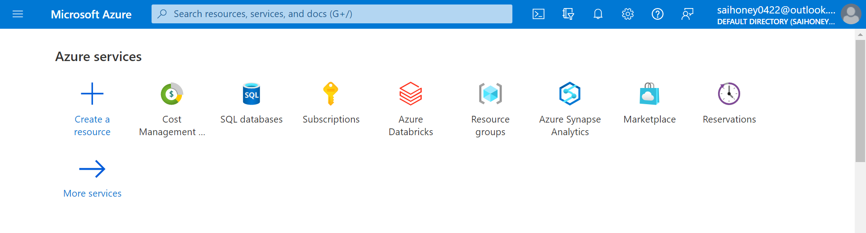
Azure Portal

Slide 3
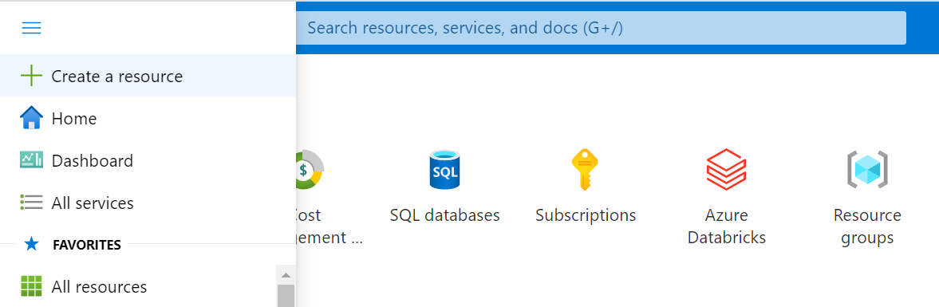

RESOURCE
A RESOURCE IS A SERVICE [TOOL/DATABASE/ANALYTICS], IT IS CALLED AS A SERVICE IN FORM OF RESOURCE PROVIDED BY AZURE, WHICH CAN BE ACCESSED FROM AZURE PORTAL. EVERY RESOURCE MUST BE PART OF RESOURCE GROUP.

Slide 4
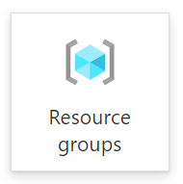
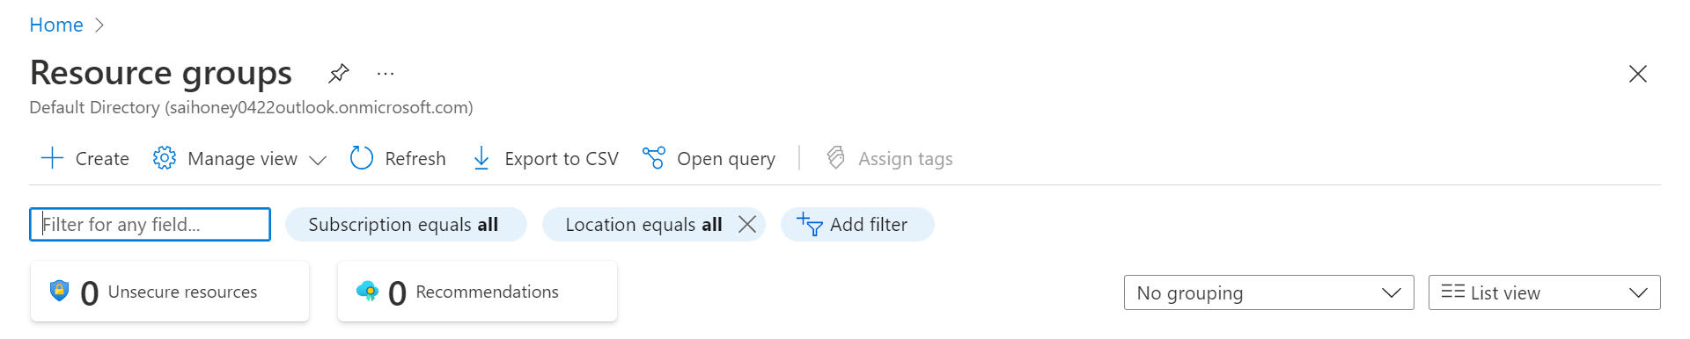
RESOURCE GROUP
A LOGICAL CONTAINER OF ALL YOUR RESOURCES, WHICH ARE MANAGED AS
SINGLE ENTITY.
EVERY RESOURCE GROUP IS MAPPED TO A SUBSCRIPTION AND REGION

Slide 5
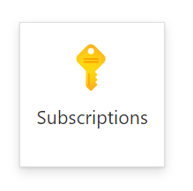
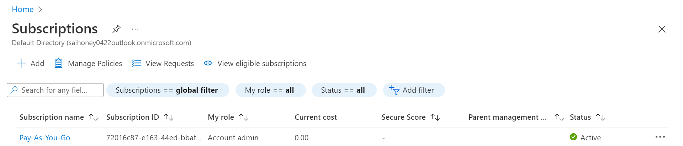
SUBSCRIPTION
Every resource group is assigned to a subscription, which defines the cost and the charges on Pay as You Go model.

Slide 6
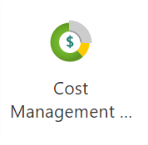
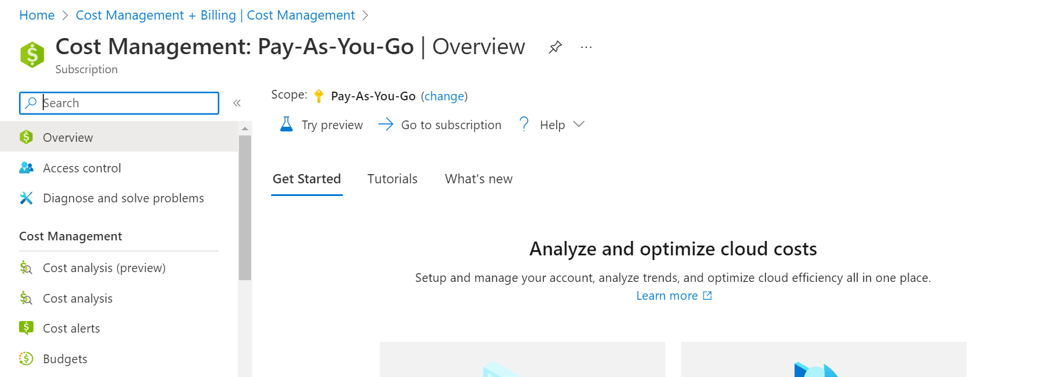
COST MANAGEMENT & ANALYSIS

Slide 7
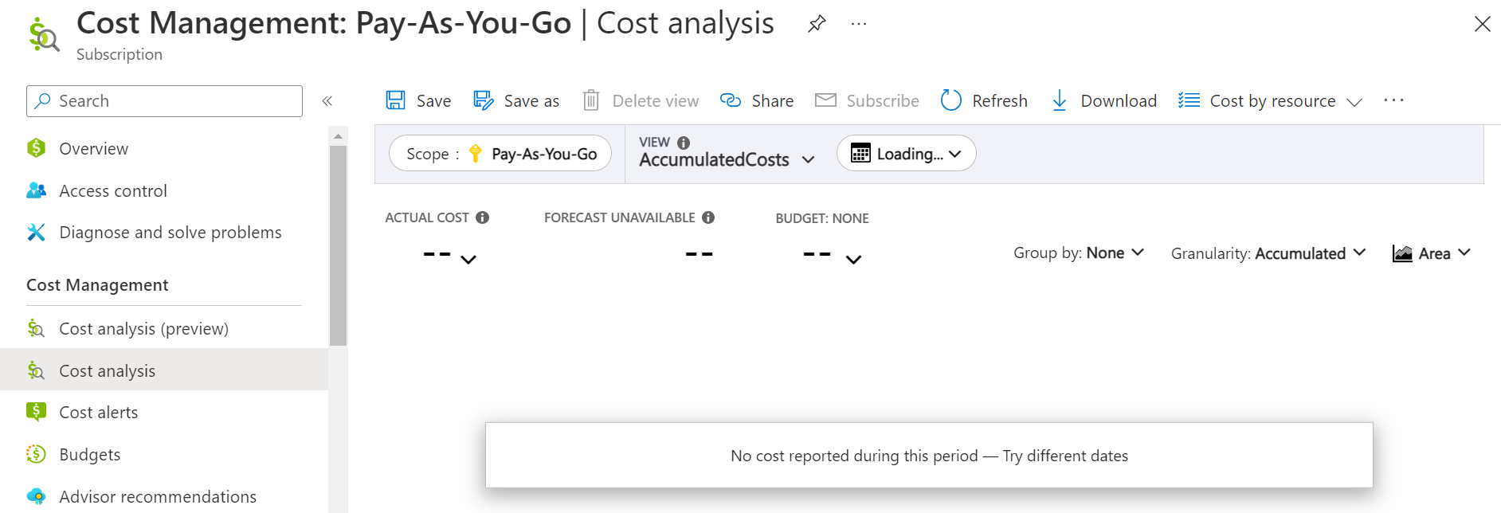
COST MANAGEMENT & ANALYSIS

Slide 8

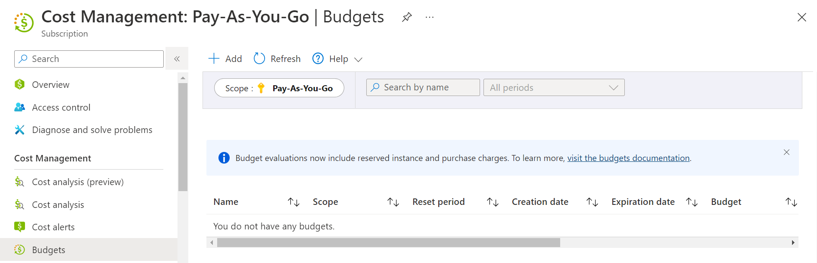
SETTING A BUDGET [ALERTS]
We can set budget [Monthly/Yearly] and set alerts as notifications to be sent once threshold of budget is reached.

Slide 9
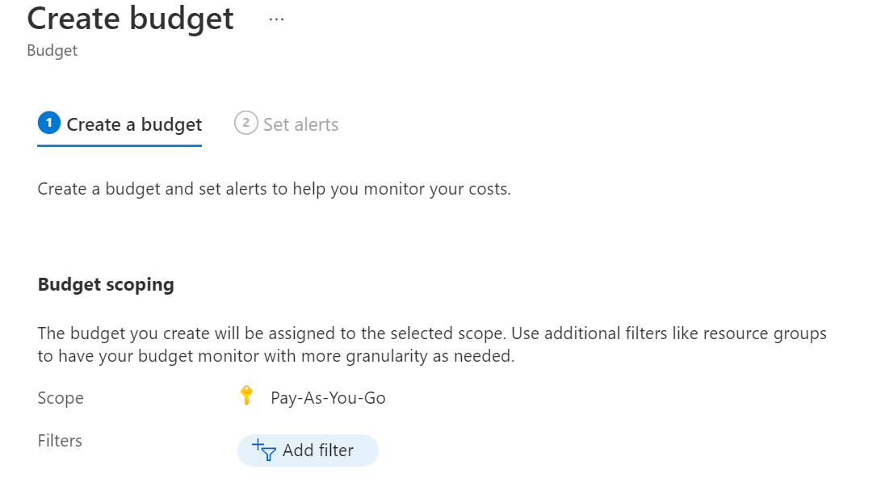
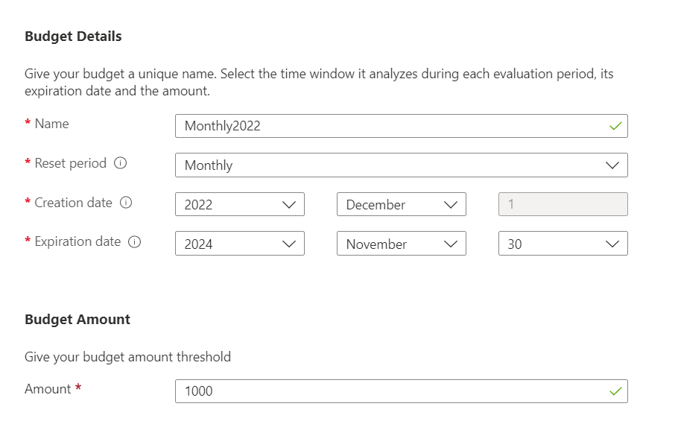
SETTING A BUDGET [ALERTS]

Slide 10
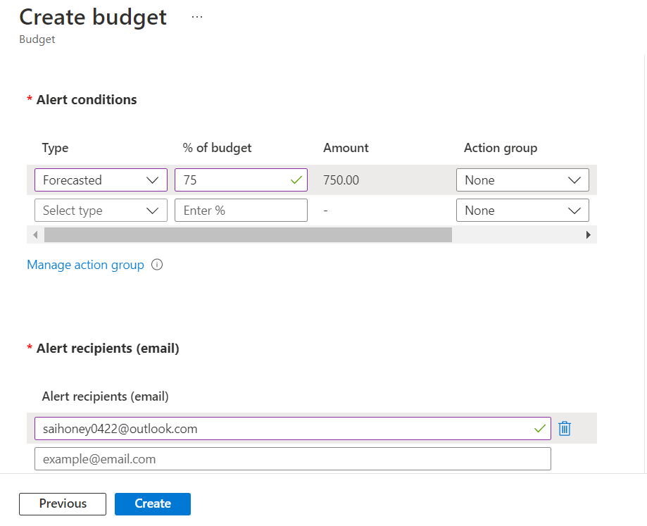
SETTING A BUDGET [ALERTS]

Slide 11

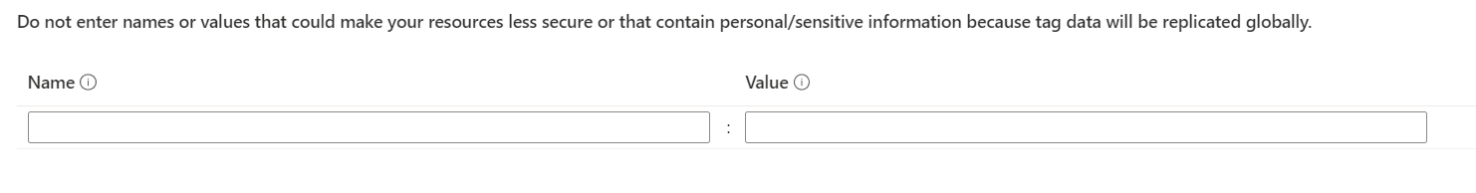
Tagging
Tags are name/value pairs that enable you to categorize resources and view consolidated billing by applying the same tag to multiple resources and resource groups. Tag names are case insensitive, but tag values are case sensitive.

Slide 12

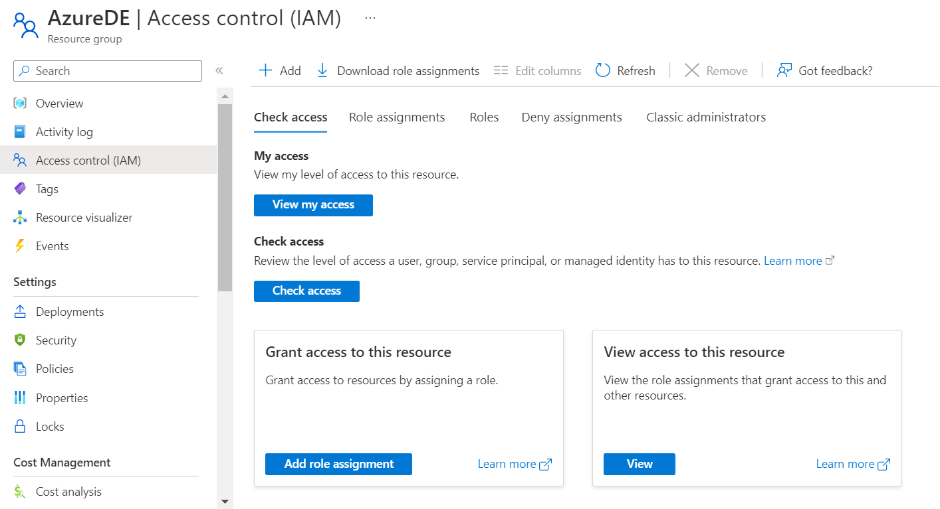
ACCESS CONTROL
IAM --> granting access and roles on resources to others

Slide 13
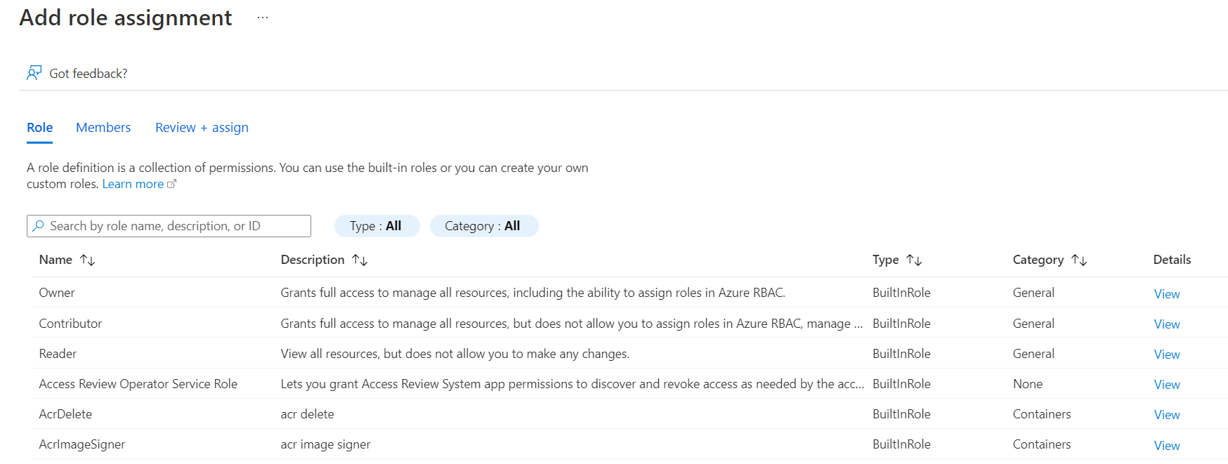
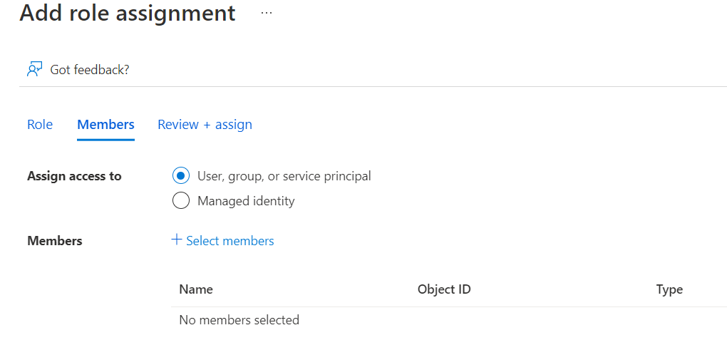
ACCESS CONTROL

Slide 14
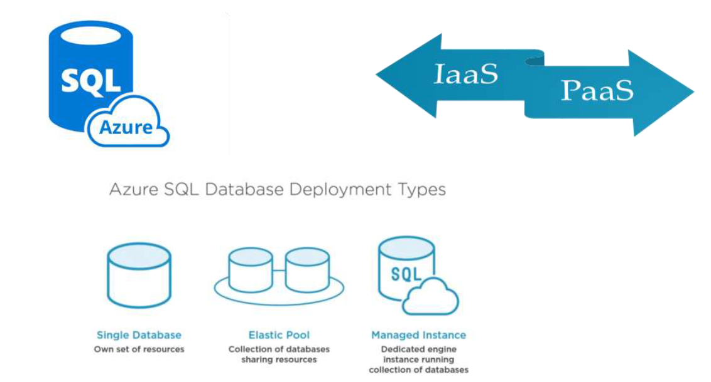
AZURE SQL DATABASE

Slide 15
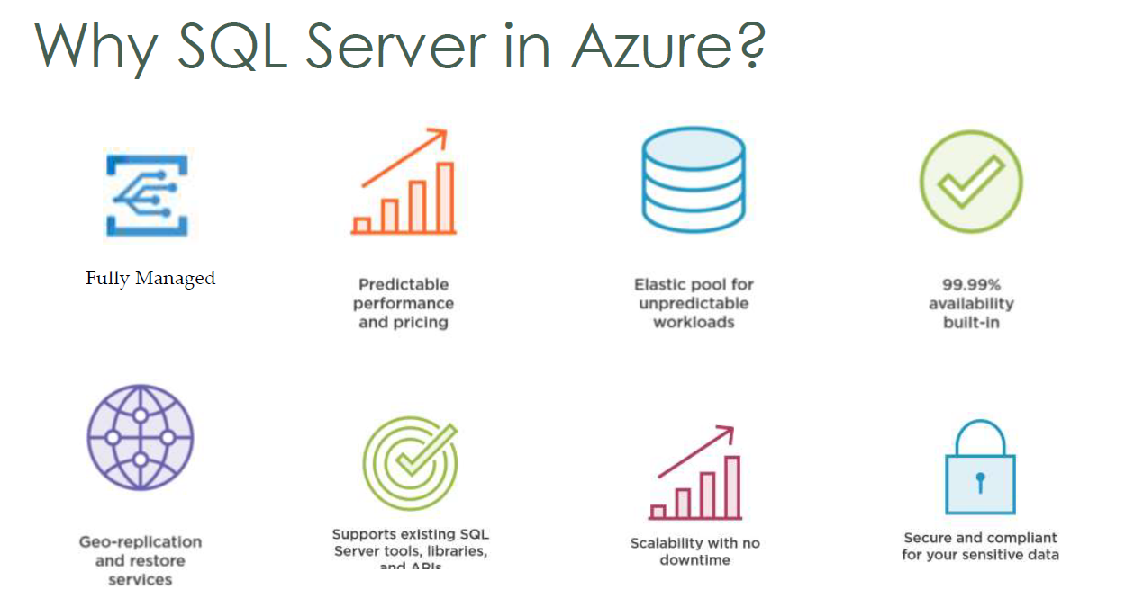
AZURE SQL DATABASE

Slide 16
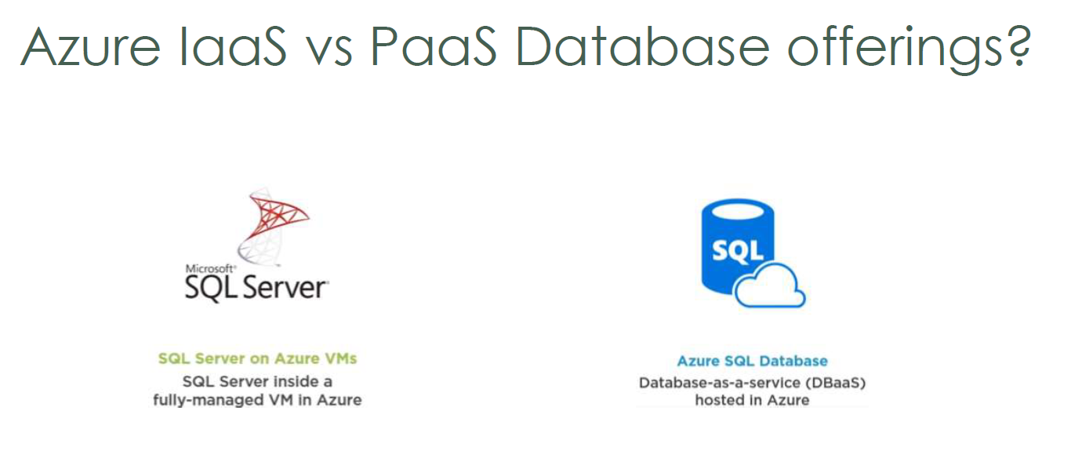
AZURE SQL DATABASE

Slide 17
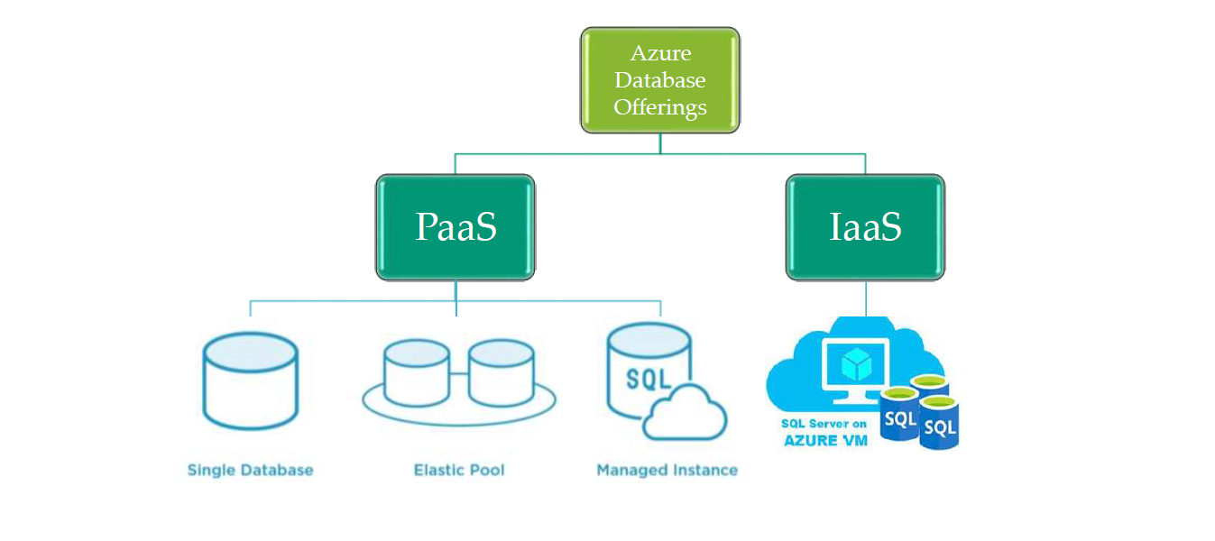
AZURE SQL DATABASE

Slide 18
AZURE SQL DATABASE

Slide 19
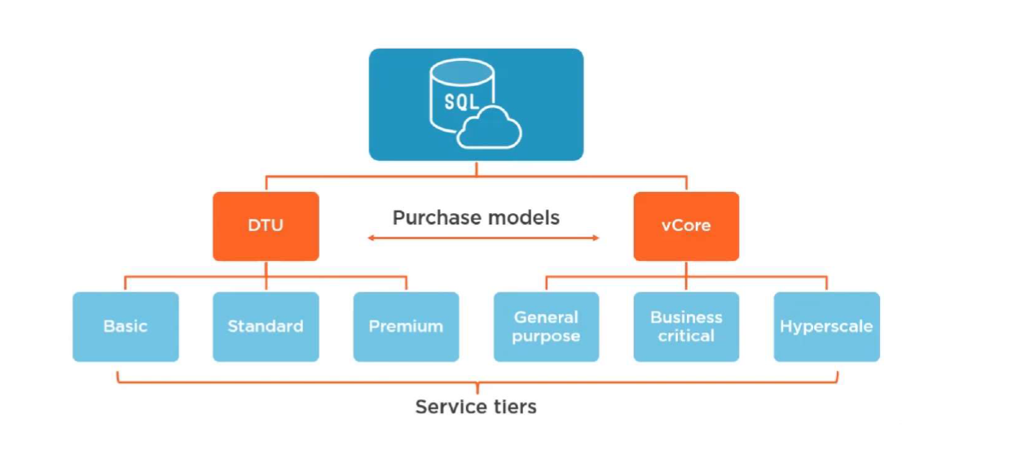
PURCHASE MODELS

Slide 20
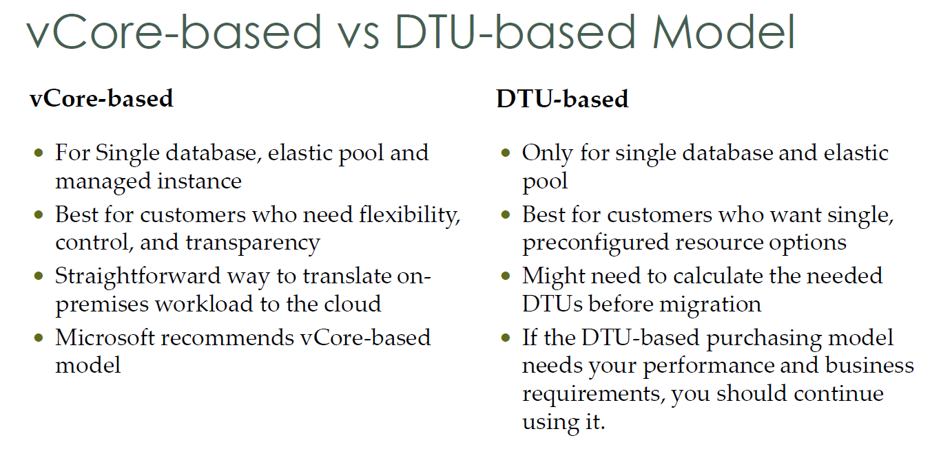

Slide 21
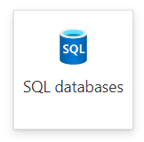
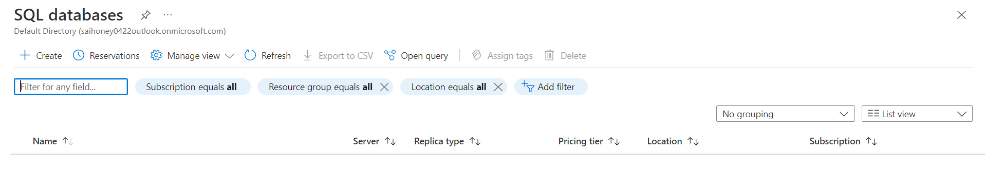
CREATING SQL DATABASE

Slide 22
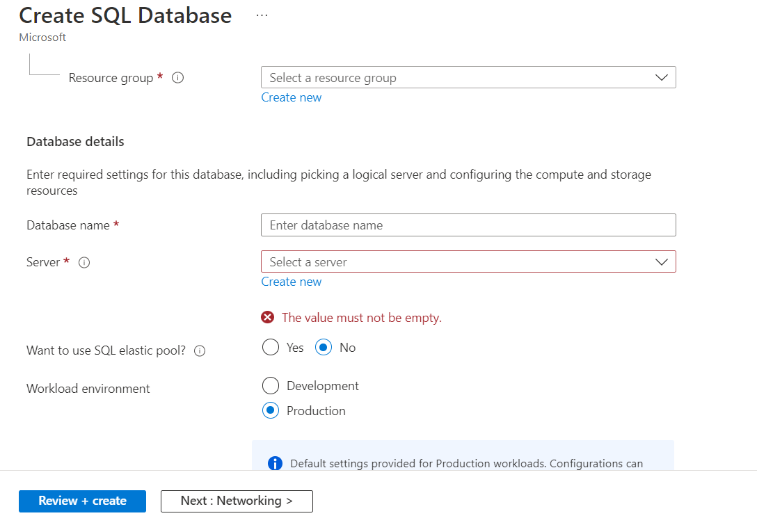
CREATING SQL DATABASE

Slide 23
CREATING SQL DATABASE
Create a resource --> Databases --> SQL database --> ADD
Database name, server [just logical database server will be used to manage group of databases --> create server [provide credentials]
server name: dbs1
location: asia south india
Authentication method: Use SQL authentication
Server Admin login: sai
Password:
Confirm Password:
want sql elastic pool : no [we can put more than one database under same pool which will share same resources]
Workload environment: Development
Compute + storage: configure database
service tier: DTU [Database Transaction Unit]--> Basic less demanding
Networking: Public endpoint, allow azure services --> Yes
Additional settings: Add sample database
Once database is created, go to database page, query editor
Overview --> Copy the server name
Go to SSMS --> paste the server name, SQL server authentication --> provide credentials

Slide 24
AZURE DATA WAREHOUSING

Slide 25
AZURE SQL DATA WAREHOUSE
AZURE SYNAPSE ANALYTICS, FORMELY KNOWN AS AZURE SQL
DATA WAREHOUSE.
2. IT MERGES ALL AZUREE DATA RESOURCES INTO SINGLE SHARED
SPACE.
[DATA POOL]
3. FOR ANY TYPE OF DATA.
4. MPP
5. COMPUTE AND STORAGE ARE SEPERATE [CHARGED SEPERATELY]
6. DWU [DATA WAREHOUSING UNIT] = CPU + MEMORY + IO
7. SCALING AND DESCALING DWH
8. WHEN NOT IN USE, COMPUTE CAN BE PAUSED.
9. STORAGE IS CHARGED ALWAYS

Slide 26
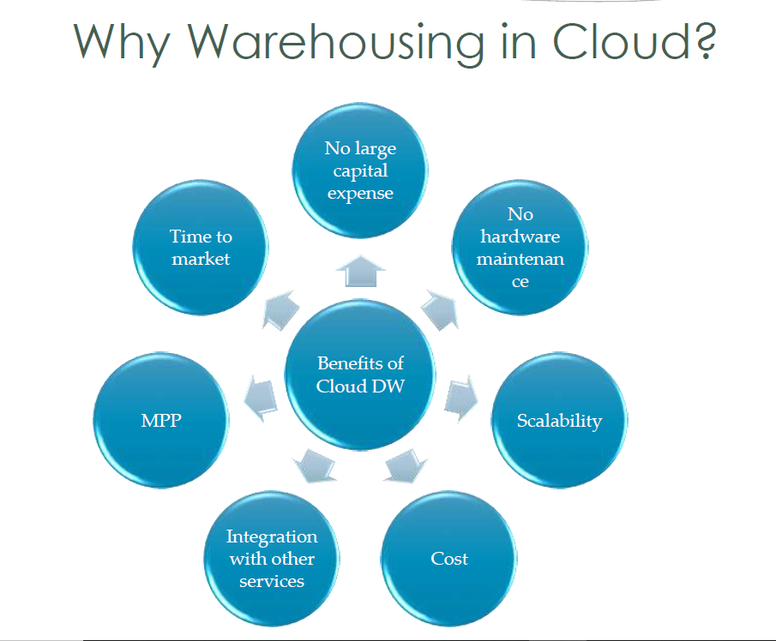

Slide 27
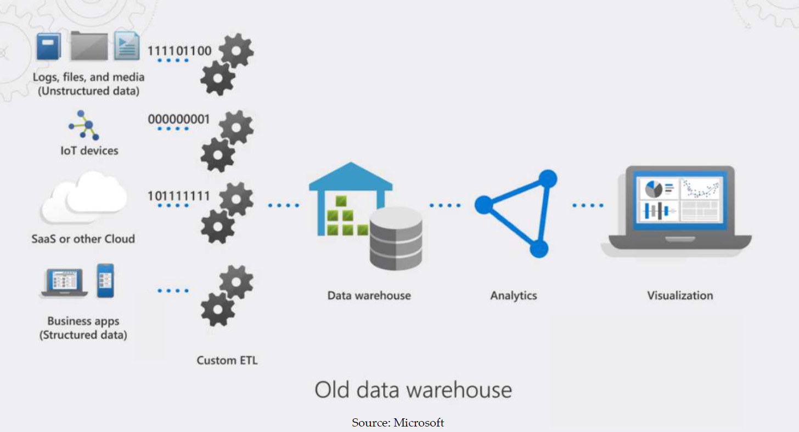

Slide 28
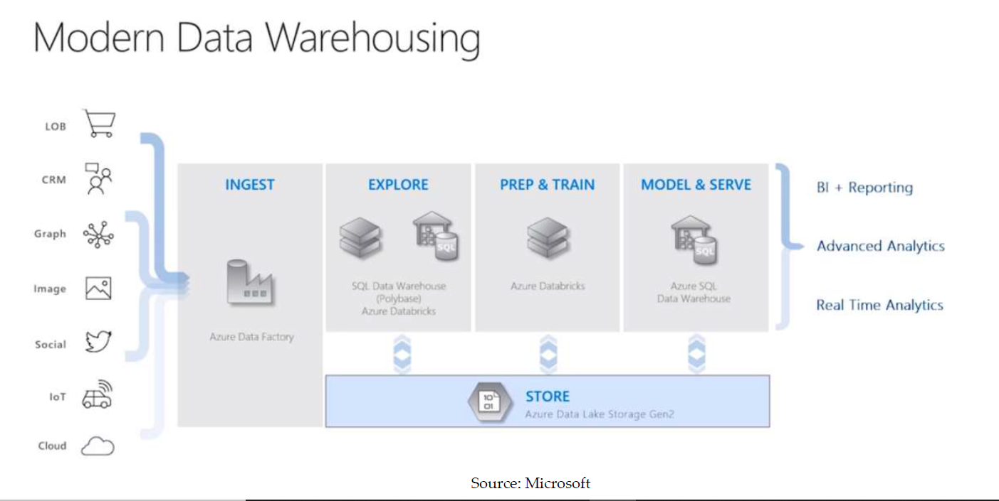

Slide 29
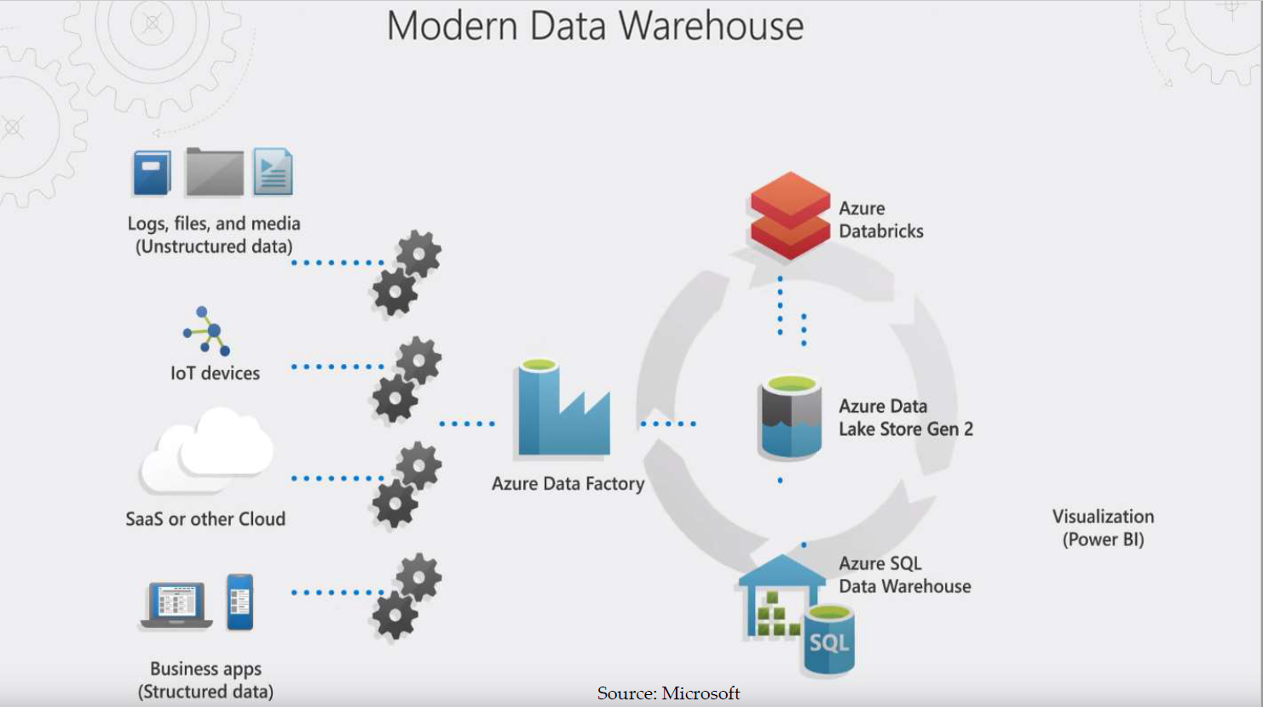

Slide 30
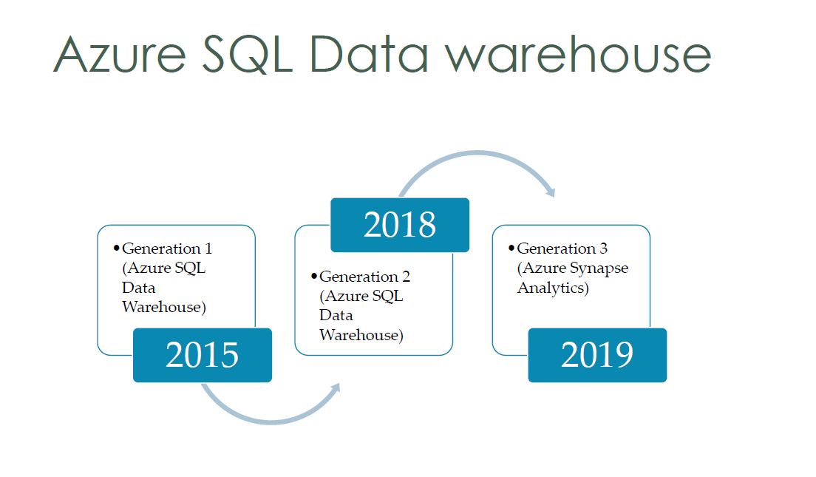

Slide 31
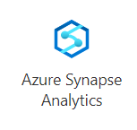
AZURE SYNAPSE ANALYTICS
Synapse is the next generation of Azure SQL Data Warehouse, blending big data analytics, data warehousing, and data integration into a single unified service that provides end to end analytics with limitless scale.

Slide 32
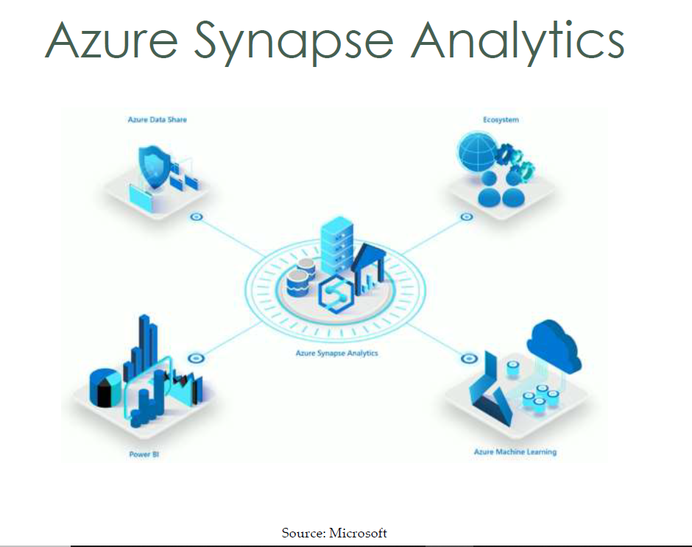

Slide 33
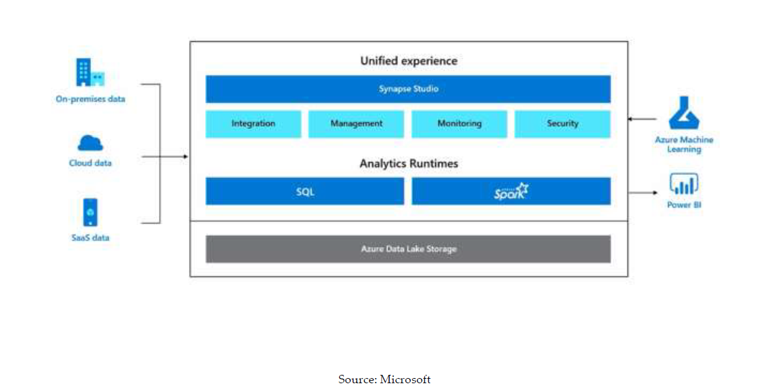
AZURE SYNAPSE ANALYTICS

Slide 34
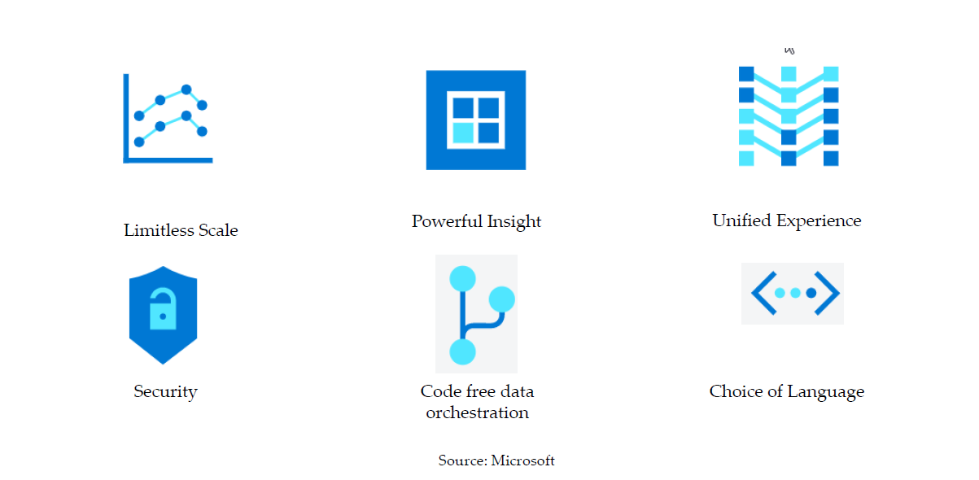
AZURE SYNAPSE ANALYTICS

Slide 35
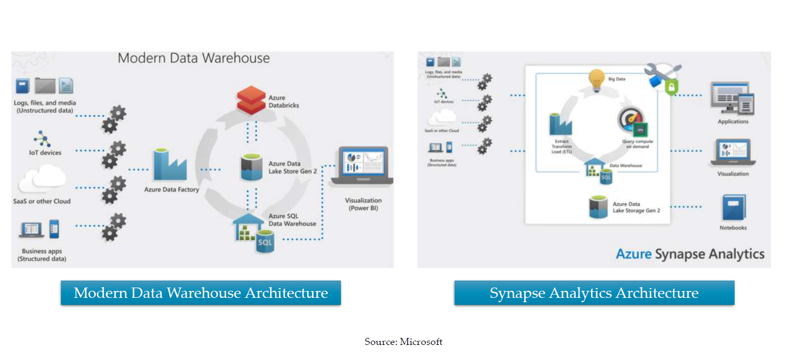

Slide 36
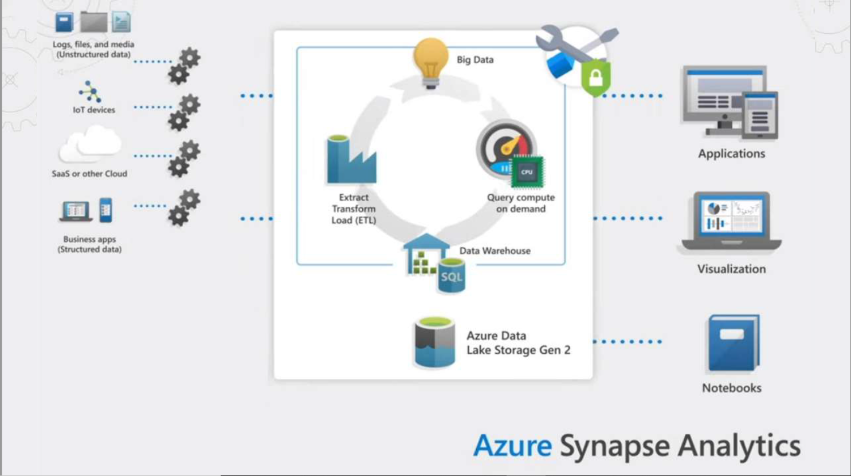

Slide 37
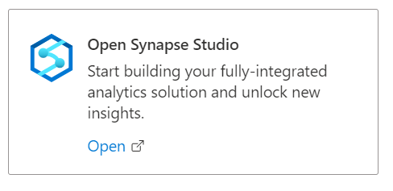
AZURE SYNAPSE STUDIO

Slide 38
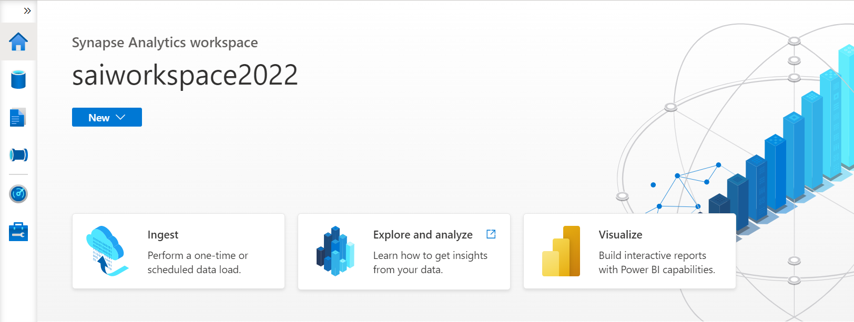
AZURE SYNAPSE STUDIO

Slide 39
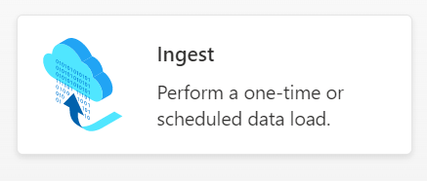
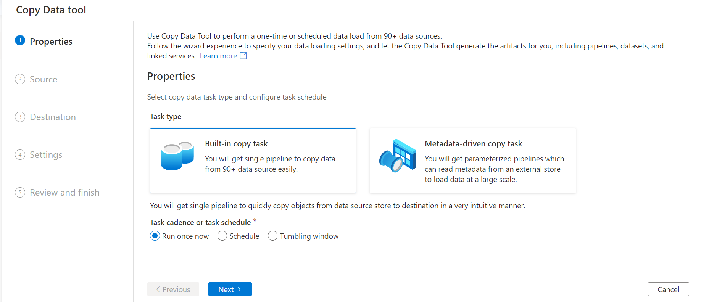
AZURE SYNAPSE STUDIO

Slide 40
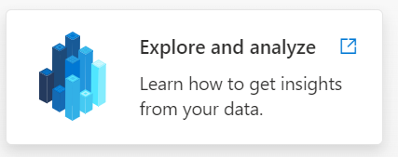
AZURE SYNAPSE STUDIO
Will open Documentation on “Explore and Analyze data lakes with serverless SQL pool”

Slide 41
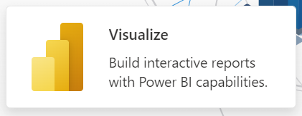
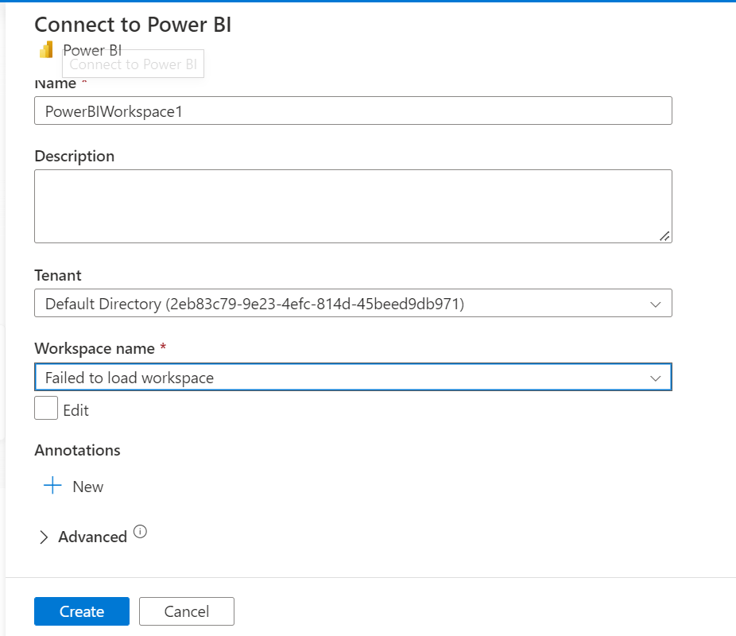
AZURE SYNAPSE STUDIO

Slide 42
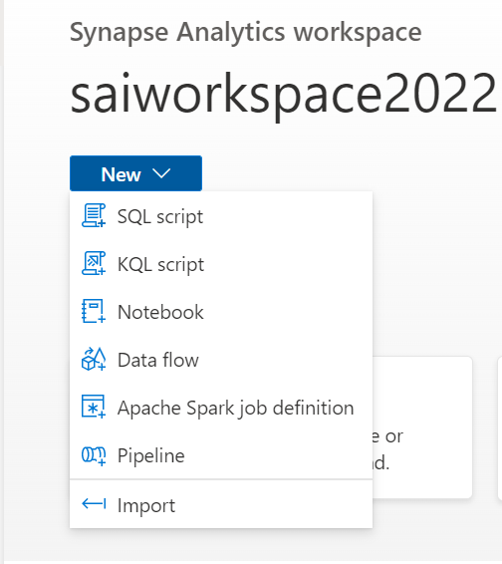
AZURE SYNAPSE STUDIO

Slide 43
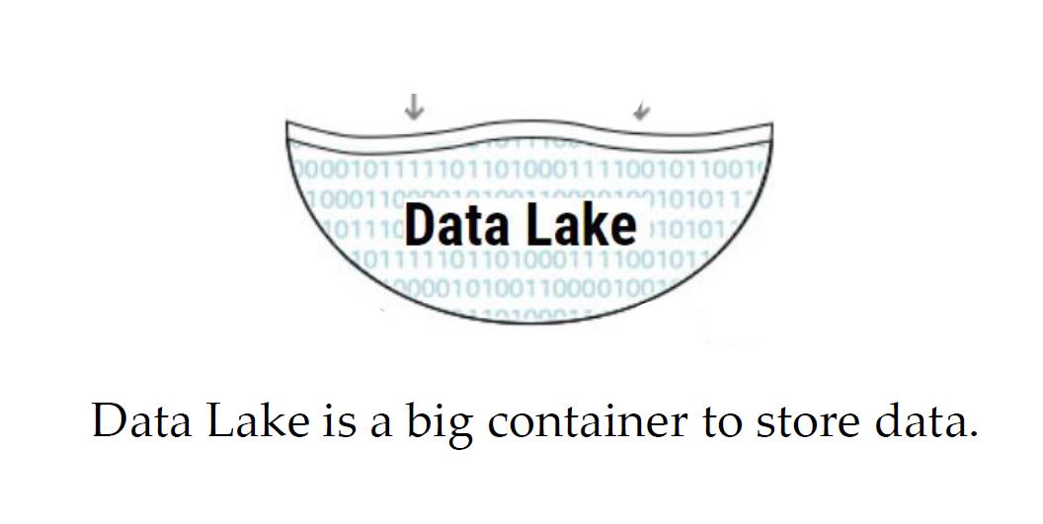
DATA LAKE

Slide 44
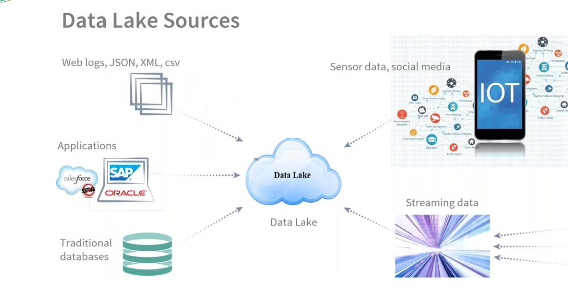
DATA LAKE

Slide 45
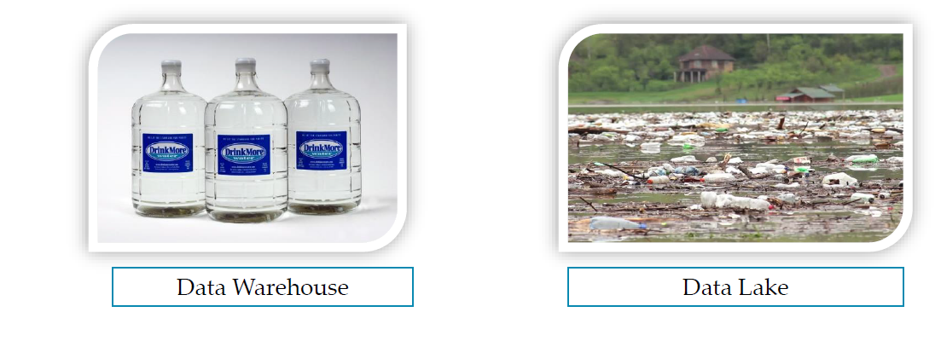
What is Data Lake?
If you think of a DataMart as a store of bottled water clean and packaged and structured for easy consumption the data lake is a large body of water in a more natural state The contents of the data lake stream in from a source to fill the lake, and various users of the lake can come to examine, dive in, or take samples

Slide 46
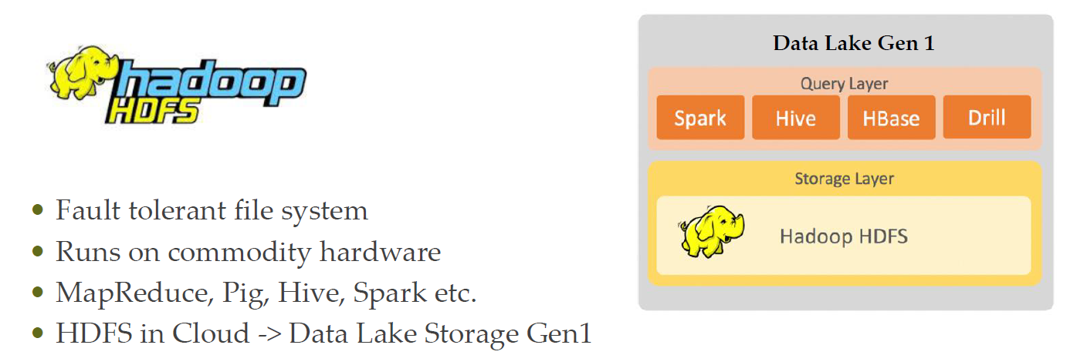
Azure Data Lake Gen1 evolution

Slide 47
Azure Blob Storage
Large object storage in cloud
Optimized for storing massive amounts of unstructured data
Text or Binary Data
General purpose object storage
Cost efficient
Provide multiple Tiers

Slide 48
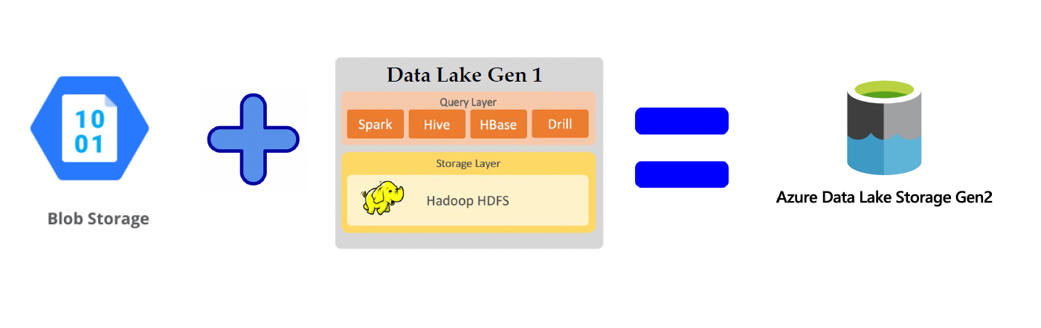
Azure Data lake Gen 2

Slide 49

Blob Storage vs Data Lake Storage

Slide 50

Data Lake Architecture

Slide 51

Data Lake Architecture

Slide 52


Slide 53


Slide 54


Slide 55


Slide 56


Slide 57


Slide 58


Slide 59


Slide 60


